Slide 1

Asheville, NC Crime Data Analysis
Examining crime proximity to police-labeled homeless encampments, and other geographic points
Prepared by Nicholas Pierson, Data Science consultant

Slide 2
5-Year Trends
911 calls & arrests peaked 2019
Both declined 2020-2021
Year | 911 Incidents | Total Arrests | Homeless Camp 911 Calls
2017 | 106114 | 10486 | 283
2018 | 111740 | 9794 | 335
2019 | 123581 | 11168 | 441
2020 | 114988 | 7905 | 470
2021 | 72586 | 7110 | 56

Slide 3
Evaluating Police Claims
Data: public data portal does not specify how total crime is defined. There were 187,574 calls to emergency services and 15,015 arrests during that 2-year time. Without a clear way to determine which non-arrest incidents are defined as ‘crime,’ our analysis uses only arrests. Therefore it is not a perfect match, but does represent a substantial proportion of total crime. We encourage the police to release the details of how they conducted their analysis.
Mapping: we construct a set of maps to illustrate flaws in the police’s chosen metric, distance from locations identified as homeless encampments.

Slide 4
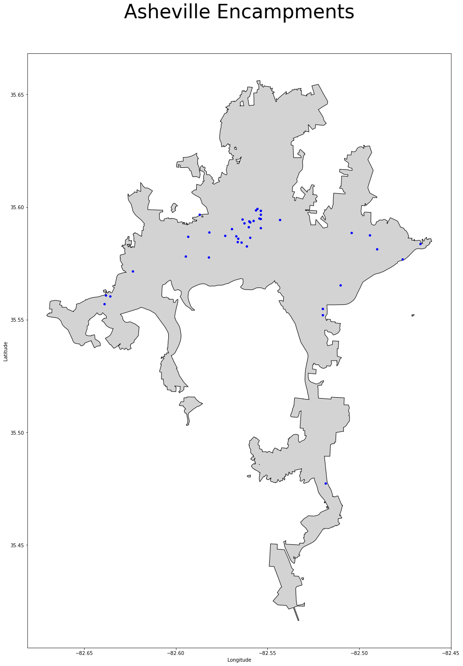
Mapping Crimes to Locations?
Police claim a high proportion of all crime occurs near “homeless encampments”
Based on their own data, these locations may be as simple as a single car, RV, or unhoused person
Police data cites 10% of 22,611 total crime within 500 feet and 22% within 1000 feet

Slide 5
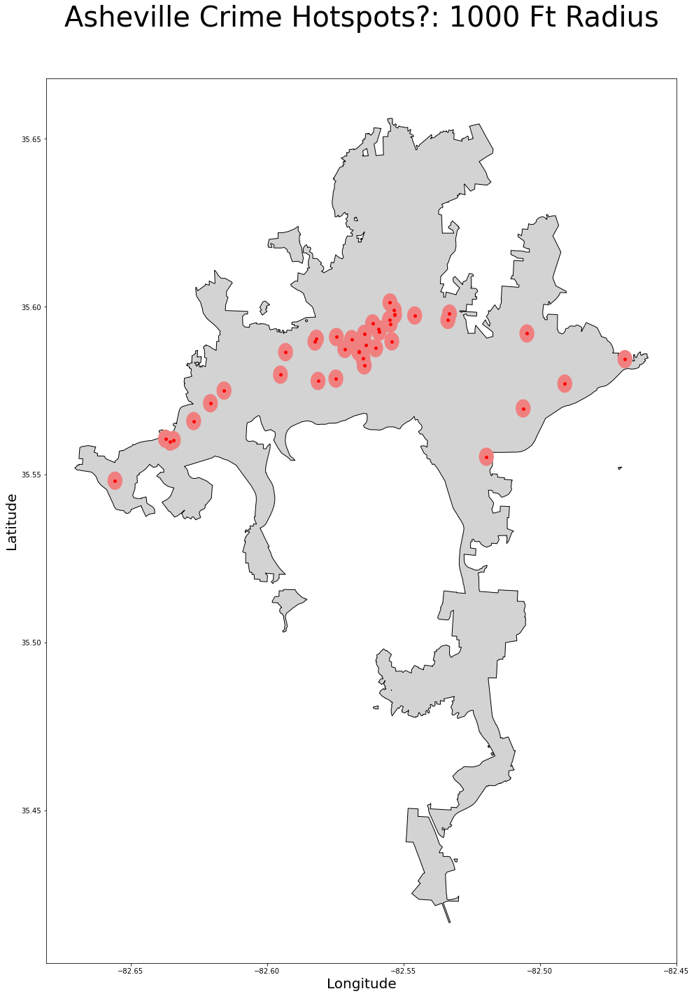
Is Crime Localized Around Hotspots?
Geotagging police arrest addresses & measuring distance shows 14.7% of arrests only (not total crime) within 500 feet and 27.1% of arrests within 1000 feet
However, a set of unrelated hotspots (right) yields almost identical results: 14.1% of arrests within 500 feet and 26.2% within 1000 feet

Slide 6
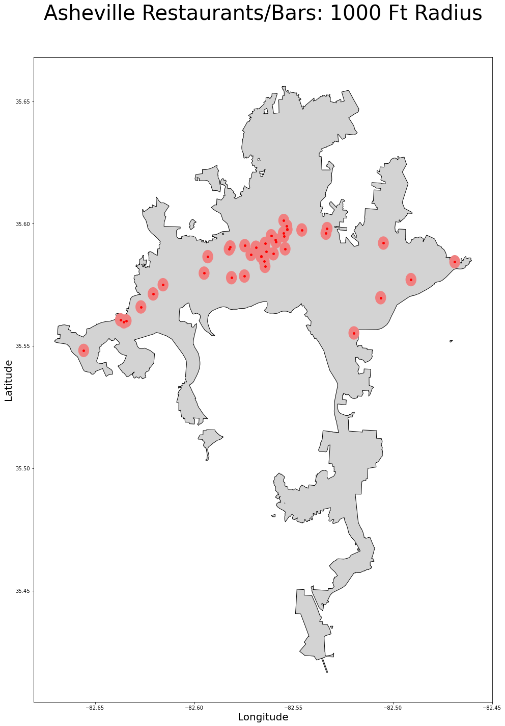
True Hotspots: Populated Areas
Almost every police site labeled as a “homeless encampment” corresponds to a populated area or business district
Our similar dataset: restaurants/bars
Crime occurs where people live, work, and spend time in general, not just where there are unhoused people living

Slide 7
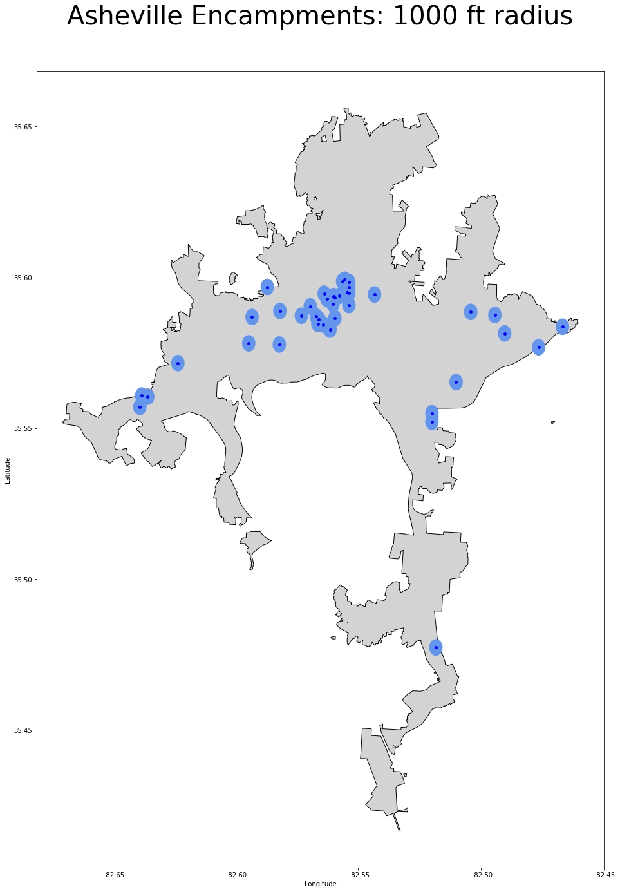
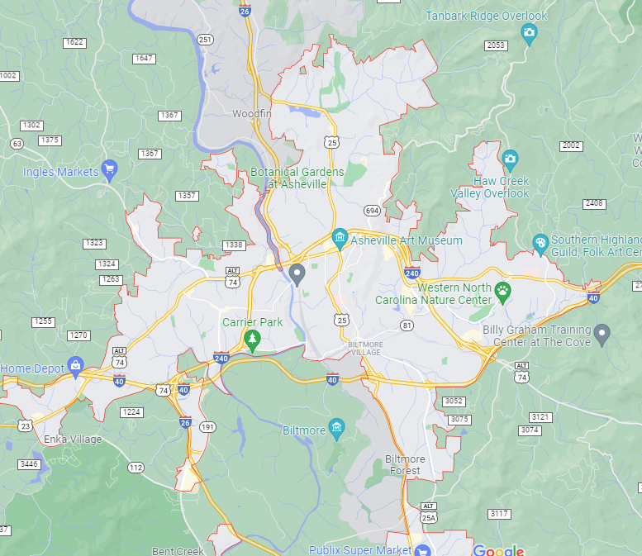
Police-labeled sites visualized
The radius around the sites labeled as encampments covers large portions of downtown & state hwy 74

Slide 8
Correlation does NOT equal Causation
Police data implies that unhoused population is responsible for a wave of crime across the city
Recalling recent trends: 911 calls and arrests have declined significantly
Increased homeless camp related 911 calls potentially correlate with difficulties of living without housing during COVID-19 pandemic
Year | 911 Incidents | Total Arrests | Homeless Camp 911 Calls
2017 | 106114 | 10486 | 283
2018 | 111740 | 9794 | 335
2019 | 123581 | 11168 | 441
2020 | 114988 | 7905 | 470
2021 | 72586 | 7110 | 56

Slide 9
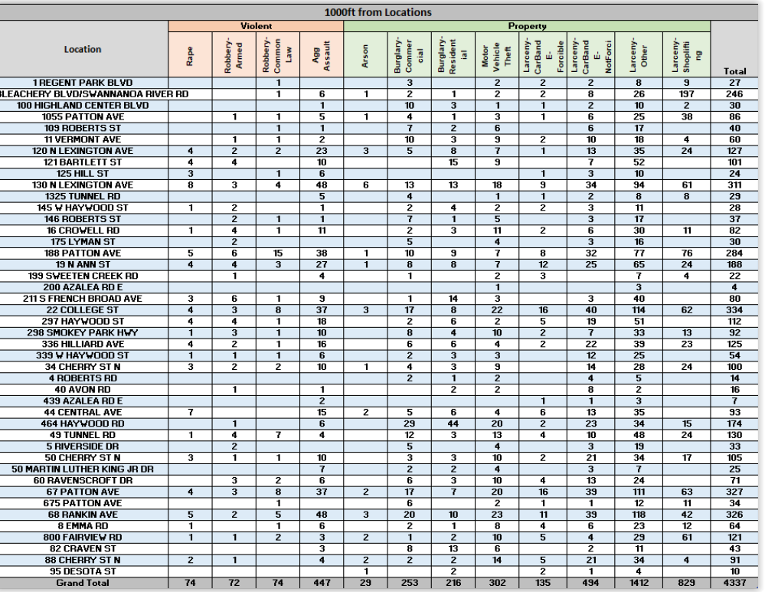
Police data errors: Duplicate Counting
Police presented tables for 500 and 1000ft tallying crimes near different locations
This does not account for crimes that occur within 500 or 1000 feet of more than one location

Slide 10
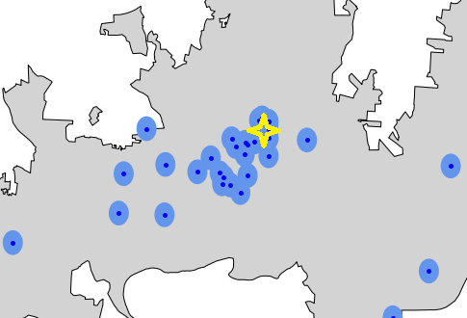
Dangers of Duplicate Counting
Using the police’s methodology, the starred location on the map would be counted as a crime six times due to its proximity to multiple locations

Slide 11
Impact of Duplicate Counting on Arrests
 | 500 Feet | 1000 Feet
True total arrests | 1957 | 3598
Multiple-counted arrests | 2449 | 7446
Overcount | 492 | 3848
Overcount % | 25.14% | 106.95%

Slide 12
Conclusion
Arrests and 911 calls have declined significantly in recent years
“Homeless encampments” range from tents to individuals in a location; these locations correlate closely to central populated areas and businesses in general
Police graphs for 500 feet and 1000 feet used incorrect methodology, counting single incidents multiple times if they occurred within range of more than one location
Duplicate counting massively overstates crime (25% for arrests within 500 feet, nearly 107% for arrests within 1000 feet)

